Slide 1
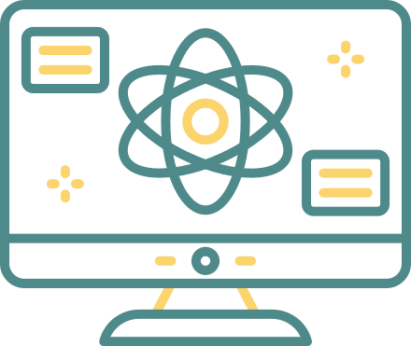

UANTUM COMP
Digitally Sure

Slide 2
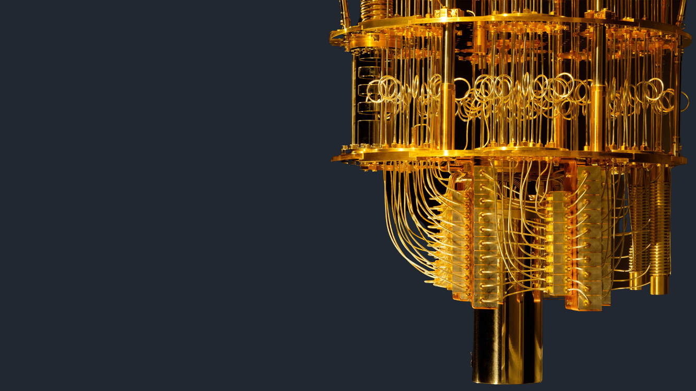
What Is Quantum Computing?
Quantum computing is an area of computer science that uses the principles of quantum theory. Quantum theory explains the behavior of energy and material on the atomic and subatomic levels.
Quantum computing uses subatomic particles, such as electrons or photons. Quantum bits, or qubits, allow these particles to exist in more than one state (i.e., 1 and 0) at the same time.
Theoretically, linked qubits can "exploit the interference between their wave-like quantum states to perform calculations that might otherwise take millions of years."
Classical computers today employ a stream of electrical impulses (1 and 0) in a binary manner to encode information in bits. This restricts their processing ability, compared to quantum computing.

Slide 3



Uses and Benefits of Quantum Computing
Quantum computing could contribute greatly to the fields of security, finance, military affairs and intelligence, drug design and discovery, aerospace designing, utilities (nuclear fusion), polymer design, machine learning, artificial intelligence (AI), Big Data search, and digital manufacturing.
Quantum computers could be used to improve the secure sharing of information. Or to improve radars and their ability to detect missiles and aircraft. Another area where quantum computing is expected to help is the environment and keeping water clean with chemical sensors.

Slide 4
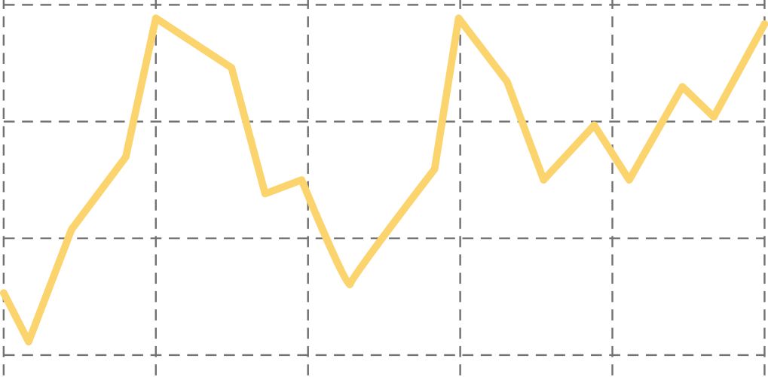



Here are some potential benefits of quantum computing:
Financial institutions may be able to use quantum computing to design more effective and efficient investment portfolios for retail and institutional clients. They could focus on creating better trading simulators and improving fraud detection.
The healthcare industry could use quantum computing to develop new drugs and genetically-targeted medical care. It could also power more advanced DNA research.
For stronger online security, quantum computing can help design better data encryption and ways to use light signals to detect intruders in the system.
Quantum computing can be used to design more efficient, safer aircraft and traffic planning systems.

Slide 5



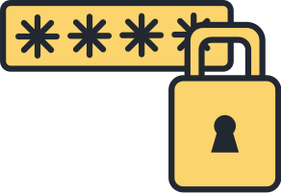
Limitations of Quantum Computing
Quantum computing offers enormous potential for development and problem-solving in many industries. However, currently, it has its limitations:
Decoherence, or decay, can be caused by the slightest disturbance in the qubit environment. This results in the collapse of computations or errors to them. As noted above, a quantum computer must be protected from all external interference during the computing stage.
Error correction during the computing stage hasn't been perfected. That makes computations potentially unreliable. Since qubits aren't digital bits of data, they can't benefit from conventional error correction solutions used by classical computers.
Retrieving computational results can corrupt the data. Developments such as a particular database search algorithm that ensures that the act of measurement will cause the quantum state to decohere into the correct answer hold promise.
Security and quantum cryptography is not yet fully developed.

Slide 6


How Much Does a Quantum Computer Cost?
A quantum computer cost billions to build. However, China-based Shenzhen SpinQ Technology plans to sell a $5,000 desktop quantum computer to consumers for schools and colleges. Last year, it started selling a quantum computer for $50,000.12
How Fast Is a Quantum Computer?
A quantum computer is many times faster than a classical computer or a supercomputer. Google’s quantum computer in development, Sycamore, is said to have performed a calculation in 200 seconds, compared to the 10,000 years that one of the world’s fastest computers, IBM's Summit, would take to solve it.13 IBM disputed Google's claim, saying its supercomputer could solve the calculation in 2.5 days. Even so, that's 1,000 times slower than Google's quantum machine.14

